Slide 1
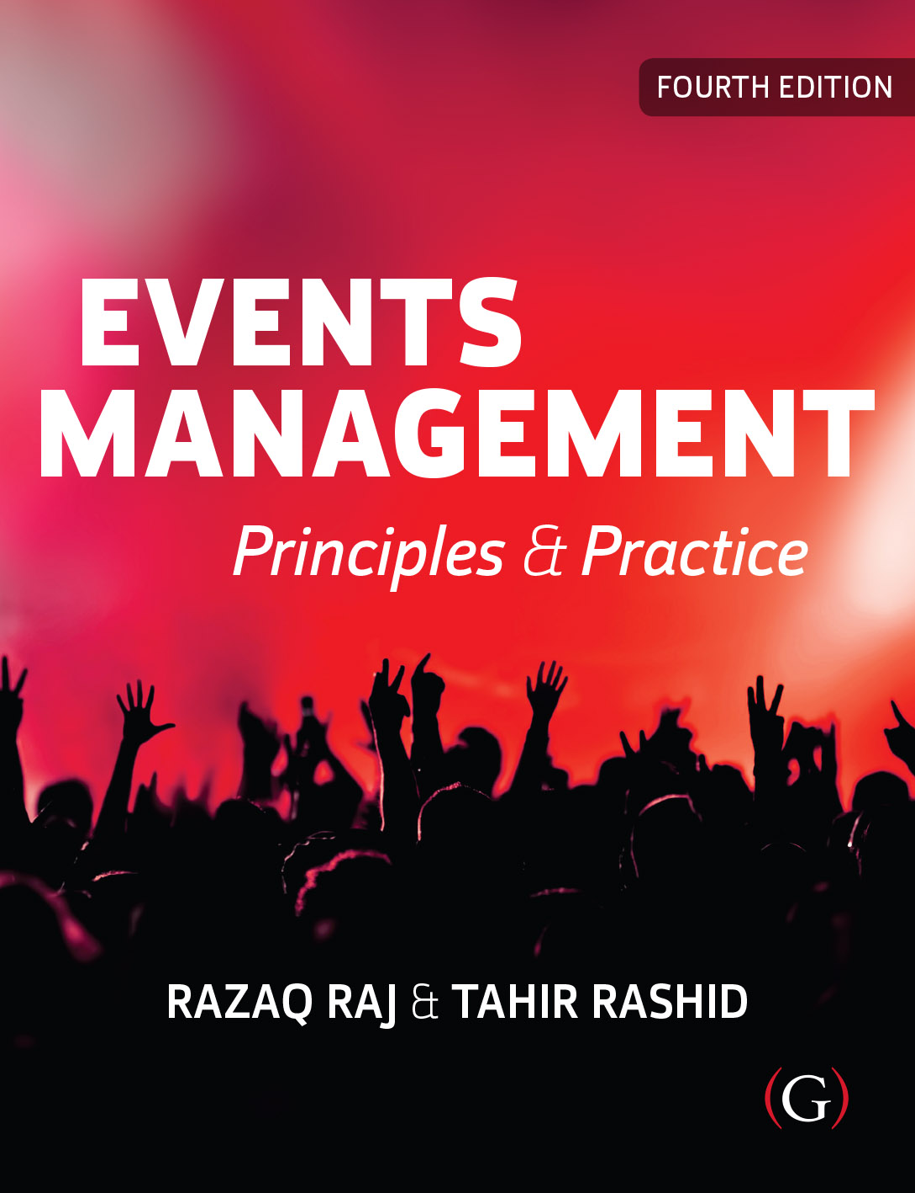
Events Management: Principles & Practice, 4th Edition
By Razaq Raj and Tahir Rashid

Slide 2
Chapter 13
Events Preparation and Operation
These are some bullet points:
This chapter present an integrated model for the successful planning of events, based on the authors’ approach to planning as a generic subject area.
The whole concept of events and festivals planning and monitoring has been changed in year 2020, due to Coronavirus disease 2019 (COVID-19) epidemic.
It has presented greater challenges to events managers, organisations, countries of Mass Gatherings.
This process will be a prelude to the presentation of a successful event plan, constructed around seven key stages.

Slide 3
Event Planning and Monitoring Concepts
Watt (2001: 6) sets out seven stages within the planning process:
  Idea and proposal
  Feasibility study
  Aims and objectives
  Implementation requirements
  Implementation plan
  Monitoring and evaluation and
  Future practice.

Slide 4
Event Planning and Monitoring
The planning process, mechanism or system that an organisation employs to realise an event is, in part, embedded in past experience.
Before deconstructing and reinventing suitable integrated planning mechanisms, always ook at an integrated reinterpretation
Thomas (2019) further argues that the purpose of the planning and monitoring of event is a practice that being used by event and festival organisations.

Slide 5
Event Planning and Monitoring
Within the planning process, the movement of people within the site boundaries must be clearly defined.
To maintain control and safety, it is vital to identify the areas where contractors can obtain access, both prior to, during and after the event.
Those attending the festival must be allocated sufficient space for movement at any given time throughout the event, taking into consideration the health and safety issues arising at different times of the day and night and from all possible weather conditions.

Slide 6
Planning Process
As the planning process develops
The risk assessment document, if the event planners are to ensure that such hazards can be assessed and managed according to health and safety regulations.
Hazards arising from the construction of the site need to be assessed before a full licence agreement will be granted for the event.
An initial assessment of anticipated hazards must be presented before a full licence is granted.
It is also necessary for the event organiser to produce a written document outlining the site rules and regulations.

Slide 7
Planning for festivals
Getz (2015, p.3) states that planned events are considered more legimate tools for host community.
“Planned events of all kinds are now viewed as legitimate tools, and this legitimation process will result in more events becoming permanent institutions. As a consequence, there exist fierce competition, gigantism (of costs, infrastructure, media coverage, and the impacts of events), and rising professionalism with new careers specific to event tourism.”

Slide 8
The Purple Guide
The Purple Guide also has an international reputation as the definitive guide for outdoor festivals and similar events.
The Purple Guide provides detailed guidance for on-site services, management and operation, both prior to and during the event.
It also describes the regulations that may impact on various aspects of the event, making particular reference to health and safety guidelines.
The document gives direction on suitable site design and the layout of amenities and basic services.
It directs event planners to the other guidance documents, legislation and regulations that they need in order to manage an outdoor festival.

Slide 9
Planning for conferences
The structuring of a conference, on the other hand, will be greatly influenced by the building or location in which it will be held.
The planning of other events may be constrained to varying degrees by licence, location and building factors.
Although there will be similarities to the processes used in festival planning, there are also specific issues to be considered when planning for a conference.
The conference organiser should firstly undertake research and conduct a feasibility study.

Slide 10
Evaluation and Reporting of the Events
The event manager needs to ask following key points:
Did event meet the set objectives
To measure and analyse whether the event has met the set targets
o investigate if the event met the expectations of all attendees and participants
Carryout feedback to improve the success and shortfall of future events

Slide 11
Evaluation and Reporting of the Events
To carryout successful event evaluation event manager needs to collect appropriate following data to have successful analysis:
  Visitor and attendees statistic- (attendance data and profiles)
  Financial data analysis – (sales figures, expenditure figures, tickets data)
  Marketing of event (posters, press releases and PR, adverts, media)
  Event welfare, accidents, complaints and thefts
  Sponsorship value and numbers
  Number of retaliers, exhibitors and enterprises
  Events planning schedule and implementation

Slide 12
Evaluation of the Events
Event evaluation is essential part of the event industry, because events is very expensive to organise and take lot of time and effort.
It is essential to learn from previous events and analyse key evidence that worked well during the event.
Improve practices that did not perform up to aims and objectives of the set out by the event organiser.
Event evaluation will also help the other organisers and provide information to key funders and partners.

Slide 13
Pandemic Impact on Planning of Events and Festivals
The assessing, planning and monitoring of festivals and events approach needs to change in future to meet the pandemic challenges.
Since break out of the COVID-19 in 2020 steps has been taken by the sporting, musical, religious, conference and other Mass Gathering has been cancelled or postponed.
Appropriate public health guidelines and interventions for reducing the risk of COVID-19.
Future pandemic of infectious disease transmission at Mass Gatherings to implement comprehensive planning processes in place.

Slide 14
Summary
Events planning for an event is a logical, systematic and yet fluid process.
Developing a generic planning process that integrates not just the event, but the business and sector that supports it.
Where a business undertakes a new type of event, the business risk development plan can ascertain the level of financial impact on the business in sustaining the process and delivery of the event.
Event planning and to give a greater understanding of the organisation supporting the planning process and event.

